Slide 1
CRIME + NFL
Team CAKI
(Chad, Alec, Karl, Iris)

Slide 2

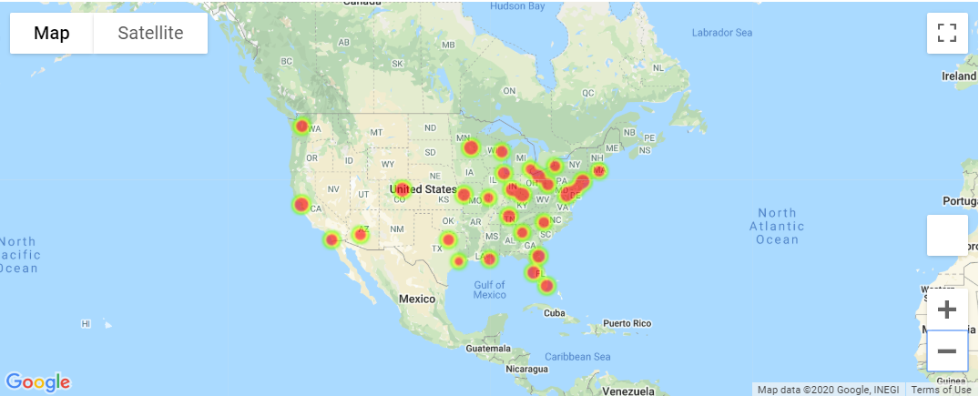
HEAT MAP: TOTAL CRIMES BY TEAM
CODE
VISUALIZATION
ANALYSIS
THE EAST COAST HAS THE MAJORITY OF THE CRIMES
MINNISOTA VIKINGS HAD THE MOST CRIMES OF ANY TEAM
HOUSTON TEXANS HAD THE FEWEST CRIMES OF ANY TEAM

Slide 3
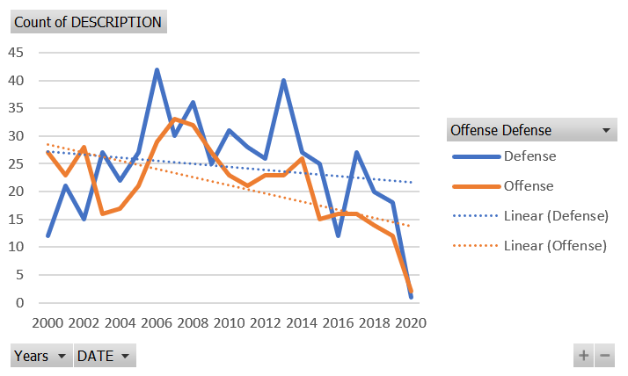
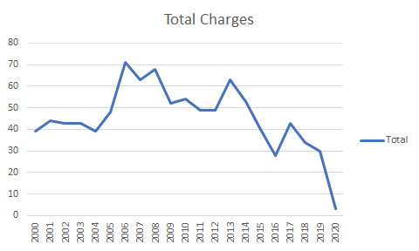
Line Graph of Total Crimes Per Year
Both offense and defense athletes are trending down from a total crimes committed

Slide 4
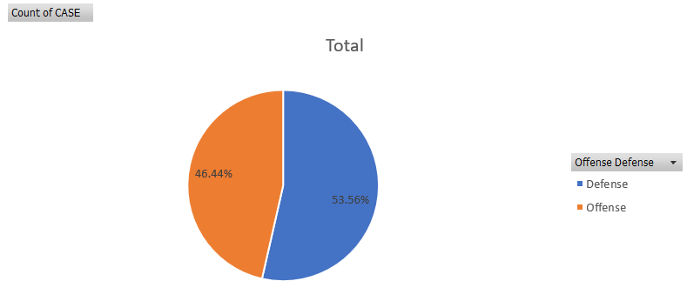
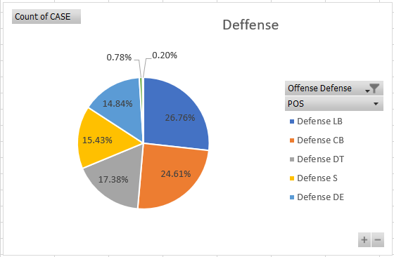
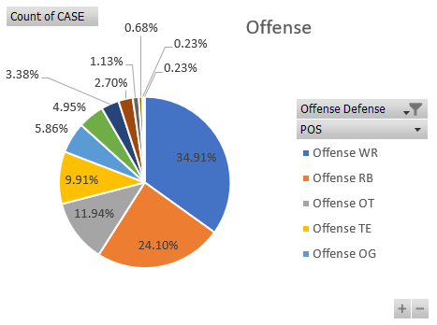
Pie Chart Crime by Offense or Defense
What do we learn about this?
Defensive players have a greater % of crimes committed.
What kind of Crimes are they committing?

Slide 5
HEADER – TOPIC/QUESTION
CODE IMAGE
VISUALIZATION
ANALYSIS

